Slide 1

NYU TANDON CAREER HUB · FALL 2026
Data Science Bootcamp
Week 3 · Exploratory Data Analysis & Data Visualization
Instructor: Angelin Ann Jacob
Section 1 · Tue Oct 13
Section 2 · Thu Oct 15
Notes:
Welcome to Week 3. Last week we learned the pandas tools; today we use them to explore a real dataset from start to finish: every planet found outside our Solar System. Today is hands-on: you will predict, write the code and post your answers in the Zoom chat.

Slide 2
Useful Links
Zoom
Brightspace
GitHub
All sessions are virtual. Use ONLY your NYU SSO Login to be considered for attendance
Assignments, submissions and the discussion board, monitored Monday to Thursday.
Slides and Colab notebooks for every session.
Email
1:1 coaching
datasciencebootcamp@nyu.edu for questions, extensions and attendance approvals.
Optional 30-minute technical interview prep. Book it through Handshake.
Data Science Bootcamp · Fall 2026
2
Notes:
Quick reminder: log in to Zoom with your NYU SSO so attendance counts. Slides and the Colab notebook are on GitHub; the take-home is submitted on Brightspace.

Slide 3
Exploratory Data Analysis
Get to know a dataset before you trust it, model it or present it!
Data Science Bootcamp · Fall 2026
Notes:
EDA is the first thing a data scientist does with any new dataset: what is in it, can we trust it, and what patterns does it hold. Everything after today, from SQL to machine learning, starts with this step.

Slide 4
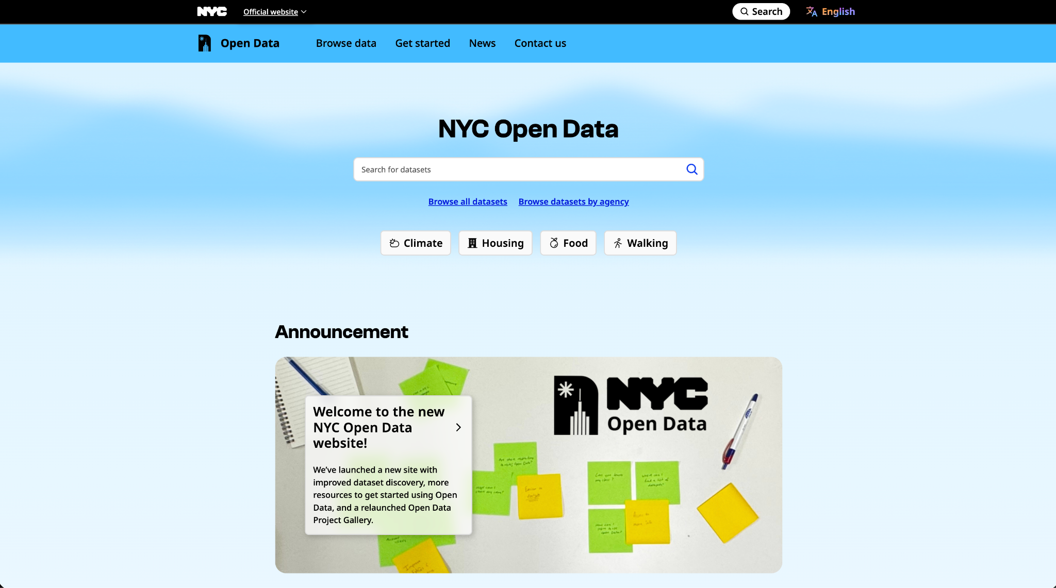
NASA Exoplanet
Archive
https://exoplanetarchive.ipac.caltech.edu
Dataset name: Confirmed planets, one row per planet (exoplanetdata, ModernDive 2026 snapshot)
Data Provided By:
NASA Exoplanet Science Institute (Caltech / IPAC)
Size: 6,278 planets, 28 columns, 192 of them found in 2026
Visit: github.com/moderndive/exoplanetdata
4
Data Science Bootcamp · Fall 2026
Notes:
Our dataset: every confirmed exoplanet in NASA's Exoplanet Archive, as a classroom snapshot from ModernDive. One row per planet, 28 columns. The chart shows discoveries per year: the two tall bars, 2014 and 2016, are years when the Kepler telescope team confirmed planets in large batches. The orange bar is 2026 so far.

Slide 5
HOW TO READ TODAY'S SESSION
Predict, code, share
PREDICT
YOUR TURN
Guess before you run
Write the code, then share
Post your guess in the Zoom chat, then run the cell and compare.
How many planets are there? Which method misses the most data?
Post your answer in the Zoom chat.
Hint open it if you are stuck
Answer open it only to check
EXAMPLE
(planets["discovery_method"]
== "Imaging").mean()
Story: What share of planets were photographed?
Data Science Bootcamp · Fall 2026
‹#›
Notes:
Every question today works the same way. Predict: post a guess in the chat before running. Your turn: write the code in the empty cell and post your answer in the chat. Hints and answers are hidden in collapsible tags. Insights stay hidden until you have posted your own.

Slide 6
Today's plan: the EDA workflow
2 · The dataset
3 · Data quality
4 · One column
5 · Two columns
6 · Insights
What did we load? Rows, columns, data types and summary statistics.
Can we trust it? Data Story 1: missing values and duplicates.
What does one column look like? Histograms, log scales, box plots.
How do two columns move together? Data Story 2: scatter plots, correlation.
What did we learn? Short insights, each backed by a number.
Data Science Bootcamp · Fall 2026
Notes:
The notebook follows the EDA workflow: first what is in the data, then whether we can trust it, then one column at a time, then two columns at a time, and finally what we learned. Two Data Stories run through it.

Slide 7
SECTION 2 · UNDERSTANDING THE DATASET
Meet the planets
THE STORY
THE TOOL
What did we just load? How big is it?
planets_raw.head() planets_raw.sample(5)
planets_raw.shape planets_raw.dtypes
Why is discovery_year a decimal (2007.0)?
planets["discovery_year"]
.astype("Int64")
Typical values. Is the mean far from the median?
planets.describe().T
# period: mean 72,082 days, median 10.7
What does one planet's card look like?
PLANET = "51 Peg b"
planets.loc[planets["planet_name"]
== PLANET].T
Data Science Bootcamp · Fall 2026
‹#›
Notes:
Section 2. Same tools as Week 2, new data. Ask the class to predict the shape first. The year column comes in as a decimal because one planet has no year: a single NaN turns the whole column into floats. describe() already hints at the story of the day: the mean orbital period is 72,082 days, the median under 11.

Slide 8
SECTION 3 · DATA QUALITY · DATA STORY 1
Most exoplanets have never been seen
Transit
Rad. vel.
Microlens.
Imaging
missing_by_method
Boxes: percent with no temperature. Below: typical distance from the star.
Only 1.5% of planets were photographed.
5%
83%
98%
35%
0.08 AU
0.9 AU
2.3 AU
156 AU
THE STORY
THE STORY
THE STORY
Which columns have gaps? Any duplicates?
Are the gaps random, or tied to the method?
Can a value be missing and still look real?
THE TOOL
THE TOOL
THE TOOL
planets.isnull().mean()
planets.duplicated().sum()
main.groupby(
"discovery_method")
["eq_temp_k"].apply(...)
METHOD = "Microlensing"
sizes.nunique()
# 134 giants, 22 radii
Data Science Bootcamp · Fall 2026
‹#›
Notes:
Data Story 1. Only imaging takes a picture of a planet; everything else is inferred from the star. So gaps are not random: temperature is missing for 5% of transit planets but 98% of microlensing planets, which sit far from their star and are cold. Filling them with the overall median (823 K) would make them far too hot, so we flag the gaps. Then the twist: radial velocity and microlensing radii sit on a perfect line because a formula filled them in.

Slide 9
SECTION 4 · ONE VARIABLE AT A TIME
Most planets finish a year in days
0.09
4.3
10.7
38
…
402M
THE STORY
Orbital period in days: min, Q1, median, Q3 … max
How long is a typical exoplanet year?
np.log10(period)
Median: 10.7 days. 83% of planets have a shorter year than Mercury (88 days).
under 1 day → over 10,000 days
normal scale
one 402-million-day year squashes it all into one bar
THE TOOL
log scale
period.median() # 10.7
(period < 88).mean() # 0.83
plt.hist(np.log10(period), bins=50)
sns.boxplot(data=main, x=..., y=...)
one clear peak: a few days per year
taller column = more planets
Data Science Bootcamp · Fall 2026
‹#›
Notes:
Section 4. Ask for a guess of the median year first. On a normal scale one planet with a 402-million-day year squashes the histogram into one bar; the log scale counts in jumps of 10 and shows one clear peak at a few days. The little grid is that log histogram, built from the real counts. Then the box plot: why is the radial velocity box squashed at the top? Back to Data Story 1.

Slide 10
SECTION 5 · TWO VARIABLES AT A TIME · DATA STORY 2
Hot Jupiters: the planets nobody expected
Every planet
planets["hot_jupiter"]
len(hj) # 739
one row = one planet
radius > 8 Earths, year < 10 days
hot Jupiters in the data
THE STORY
THE STORY
THE STORY
Do planets with shorter years run hotter?
How hot is a typical hot Jupiter?
Which columns carry the same information?
THE TOOL
THE TOOL
THE TOOL
plt.scatter(period, temp)
ax.set(xscale="log")
# r = -0.68
hj["eq_temp_k"].median()
# 1,460 K
.nlargest(1, "eq_temp_k")
sns.heatmap(logs.corr(),
annot=True)
# period vs orbit: 0.99
Data Science Bootcamp · Fall 2026
‹#›
Notes:
Data Story 2. Before 1995 astronomers expected giant planets to orbit far from their stars, like Jupiter. Then 51 Pegasi b: a giant with a 4-day year, and a Nobel Prize in 2019. The scatter shows shorter orbits mean hotter planets (r = -0.68). 739 hot Jupiters, median 1,460 K; the hottest, KELT-9 b, reaches 4,050 K. The heat map shows which columns repeat each other (period and orbit size, 0.99).

Slide 11
SECTION 6 · DRAWING INSIGHTS
What we learned today
THE INSIGHT
THE EVIDENCE
Most exoplanets have never been seen
only 1.5% were photographed (imaging)
Missing values depend on the discovery method
temperature missing: 5% of transit,
98% of microlensing planets
Most known planets finish a year in days
median year 10.7 days; 83% shorter
than Mercury's 88-day year
Closer orbits mean hotter planets
r = -0.68; 739 hot Jupiters with a
median of 1,460 K and a 3.5-day year
Data Science Bootcamp · Fall 2026
‹#›
Notes:
Wrap-up. Ask: which insight surprised you most? One sentence in the chat. Each insight is short and backed by a number. Limitation: this is not a random sample of the galaxy, so counts tell us what is detectable, not what is common.

Slide 12
Before next week
Take-home
Feedback form
Week 4: SQL Fundamentals
Exercises 1 to 4 in today's notebook. Submit on Brightspace within one week, by 11:59 PM.
Fill it out after today's session. It counts toward your credential.
Work with databases and get familiar with SQL basics!
Data Science Bootcamp · Fall 2026
Notes:
Take-home: Exercises 1 to 4 at the end of each section of the notebook, due on Brightspace within one week. Please fill out the feedback form. Next week: SQL fundamentals.

